Slide 1
Big data processing with spark
Sourangshu Bhattacharya
CSE, IIT Kharagpur
Web: https://cse.iitkgp.ac.in/~sourangshu/
Email: Sourangshu@cse.iitkgp.ac.in

Slide 2
Big data processing

Slide 3
Motivation: Google Example
20+ billion web pages x 20KB = 400+ TB
A computer reads 30-35 MB/sec from disk
  ~4 months to read the data
~ 400 hard drives to store the data
Takes even more to do something useful with the data!
Today, a standard architecture for such problems is used:
  Cluster of commodity Linux nodes
  Commodity network (ethernet) to connect them

Slide 4
Cluster Architecture
2-10 Gbps backbone between racks
1 Gbps between
any pair of nodes
in a rack
Switch
Switch
Switch
CPU
CPU
CPU
CPU
Mem
…
Mem
Mem
…
Mem
Disk
Disk
Disk
Disk
Each rack contains 16-64 nodes

Slide 5
Large-scale Computing
Large-scale computing for data mining problems on commodity hardware
Challenges:
  How do you distribute computation?
  How can we make it easy to write distributed programs?
  Machines fail:
    One server may stay up 3 years (1,000 days)
    If you have 1,000 servers, expect to loose 1/day
    People estimated Google has ~1M machines
      1,000 machines fail every day!

Slide 6
Big Data Challenges
Scalability: processing should scale with increase in data.
Fault Tolerance: function in presence of hardware failure
Cost Effective: should run on commodity hardware
Ease of use: programmers do not write additional code for communication, fault tolerance, etc.
Flexibility: able to process unstructured data
Solution: Map Reduce !

Slide 7
Idea and Solution
Issue: Copying data over a network takes time
Ideas:
  Bring computation close to the data
  Store files multiple times for reliability
Map-reduce addresses these problems
  Elegant way to work with big data
  Storage Infrastructure – File system
    Google: GFS. Hadoop: HDFS
  Programming model
    Map-Reduce

Slide 8
What is Hadoop ?
A scalable fault-tolerant distributed system for data storage and processing.
Core Hadoop:
  Hadoop Distributed File System (HDFS)
  Hadoop YARN: Job Scheduling and Cluster Resource Management
  Hadoop Map Reduce: Framework for distributed data processing.
Open Source system with large community support.
https://hadoop.apache.org/

Slide 9
What is Map Reduce ?
Programming paradigm for seamlessly distributing a task across multiple servers.
Proposed by Dean and Ghemawat, 2004.
Consists of two developer created phases:
  Map
  Reduce
In between Map and Reduce is the Shuffle and Sort phase.
User is responsible for casting the algorithm into map – reduce framework.

Slide 10
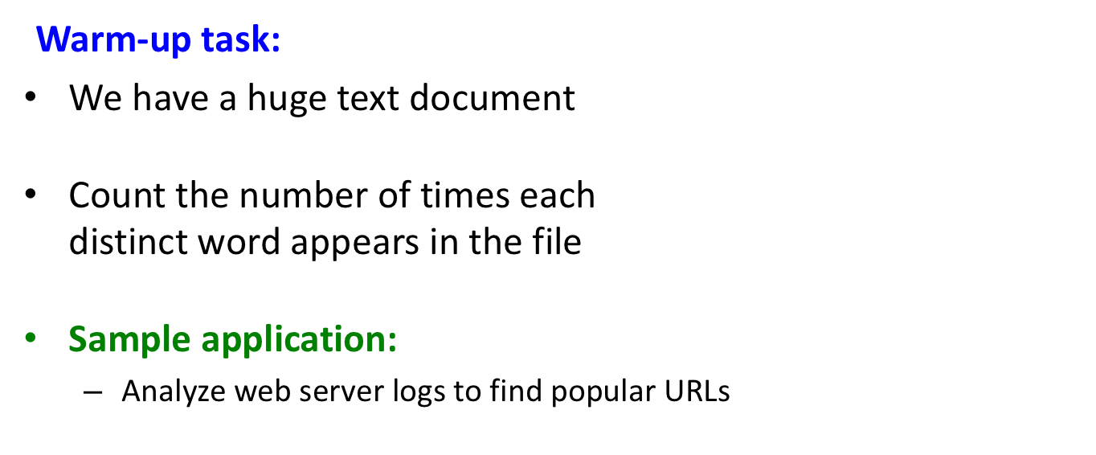
Programming Model: MapReduce

Slide 11
Task: Word Count
Case 1:
  File too large for memory, but all <word, count> pairs fit in memory
  Use a hashmap.
Case 2:
Count occurrences of words:
  words(doc.txt) | sort | uniq -c
    where words takes a file and outputs the words in it, one per a line
Case 2 captures the essence of MapReduce

Slide 12
MapReduce: Overview
Both sequentially read and write a lot of data records
Map:
  Extract something you care about
  Output is (key, value) pair
Group by key: Sort and Shuffle
Reduce:
  Process records with the same key value: e.g. Aggregate, summarize, etc.
Write the result
Outline stays the same, Map and Reduce change to fit the problem

Slide 13
More Specifically
Input: a set of key-value pairs
Programmer specifies two methods:
  Map(k, v) → <k’, v’>*
    Takes a key-value pair and outputs a set of key-value pairs
      E.g., key is the filename, value is a single line in the file
    There is one Map call for every (k,v) pair
  Reduce(k’, <v’>*) → <k’, v’’>*
    All values v’ with same key k’ are reduced together
    and processed in v’ order
    There is one Reduce function call per unique key k’

Slide 14
MapReduce: Word Counting
Provided by the programmer
Provided by the programmer
MAP:
Read input and produces a set of key-value pairs
Group by key:
Collect all pairs with same key
Reduce:
Collect all values belonging to the key and output
The crew of the space shuttle Endeavor recently returned to Earth as ambassadors, harbingers of a new era of space exploration. Scientists at NASA are saying that the recent assembly of the Dextre bot is the first step in a long-term space-based man/mache partnership. '"The work we're doing now -- the robotics we're doing -- is what we're going to need ……………………..
(The, 1)
(crew, 1)
(of, 1)
(the, 1)
(space, 1)
(shuttle, 1)
(Endeavor, 1)
(recently, 1)
….
(crew, 1)
(crew, 1)
(space, 1)
(the, 1)
(the, 1)
(the, 1)
(shuttle, 1)
(recently, 1)
…
(crew, 2)
(space, 1)
(the, 3)
(shuttle, 1)
(recently, 1)
…
Sequentially read the data
Only sequential reads
Big document
(key, value)
(key, value)
(key, value)

Slide 15
WORD COUNT USING HADOOP STREAMING
mapper.py
reducer.py
#!/usr/bin/env python3
import sys
for line in sys.stdin:
line = line.strip()
words = line.split()
for word in words:
print(f"{word}\t1")
#!/usr/bin/env python3
import sys
last_word = None
count = 0
for line in sys.stdin:
word, c = line.strip().split("\t", 1)
c = int(c)
if word == last_word:
count += c
continue
if last_word is not None:
print(last_word, count, sep="\t")
last_word = word
count = c
if last_word is not None:
print(last_word, count, sep="\t")
Running the job
hadoop jar hadoop-streaming.jar \
-input /input/docs \
-output /output/wordcount \
-mapper mapper.py \
-reducer reducer.py \
-file mapper.py \
-file reducer.py

Slide 16
Word Count Using MapReduce
map(key, value):
// key: document name; value: text of the document
for each word w in value:
emit(w, 1)
reduce(key, values):
// key: a word; value: an iterator over counts
result = 0
for each count v in values:
result += v
emit(key, result)

Slide 17
Hadoop Map Reduce
Provides:
  Automatic parallelization and Distribution
  Fault Tolerance
  Methods for interfacing with HDFS for colocation of computation and storage of output.
  Status and Monitoring tools
  API in Java
  Ability to define the mapper and reducer in many languages through Hadoop streaming.

Slide 18
HDFS

Slide 19
What’s HDFS
HDFS is a distributed file system that is fault tolerant, scalable and extremely easy to expand.
HDFS is the primary distributed storage for Hadoop applications.
HDFS provides interfaces for applications to move themselves closer to data.
HDFS is designed to ‘just work’, however a working knowledge helps in diagnostics and improvements.

Slide 20
Components of HDFS
There are two (and a half) types of machines in a HDFS cluster
NameNode :– is the heart of an HDFS filesystem, it maintains and manages the file system metadata. E.g; what blocks make up a file, and on which datanodes those blocks are stored.
DataNode :- where HDFS stores the actual data, there are usually quite a few of these.

Slide 21
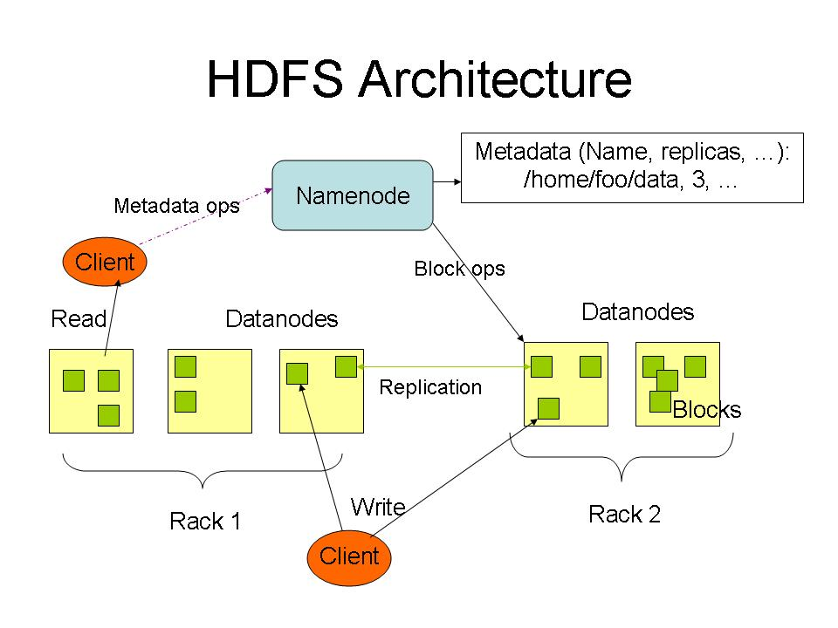
HDFS Architecture

Slide 22
HDFS
Design Assumptions
  Hardware failure is the norm.
  Streaming data access.
  Write once, read many times.
  High throughput, not low latency.
  Large files.
Characteristics:
  Performs best with modest number of large files
  Optimized for streaming reads
  Layer on top of native file system.

Slide 23
HDFS
Data is organized into file and directories.
Files are divided into blocks and distributed to nodes.
Block placement is known at the time of read
  Computation moved to same node.
Replication is used for:
  Speed
  Fault tolerance
  Self healing.

Slide 24
Goals of HDFS
Very Large Distributed File System
– 10K nodes, 100 million files, 10 PB
Assumes Commodity Hardware
– Files are replicated to handle hardware failure
– Detect failures and recovers from them
Optimized for Batch Processing
– Data locations exposed so that computations can move to where data resides
– Provides very high aggregate bandwidth
User Space, runs on heterogeneous OS

Slide 25
Distributed File System
Single Namespace for entire cluster
Data Coherency
– Write-once-read-many access model
– Client can only append to existing files
Files are broken up into blocks
– Typically 128 MB block size
– Each block replicated on multiple DataNodes
Intelligent Client
– Client can find location of blocks
– Client accesses data directly from DataNode

Slide 26
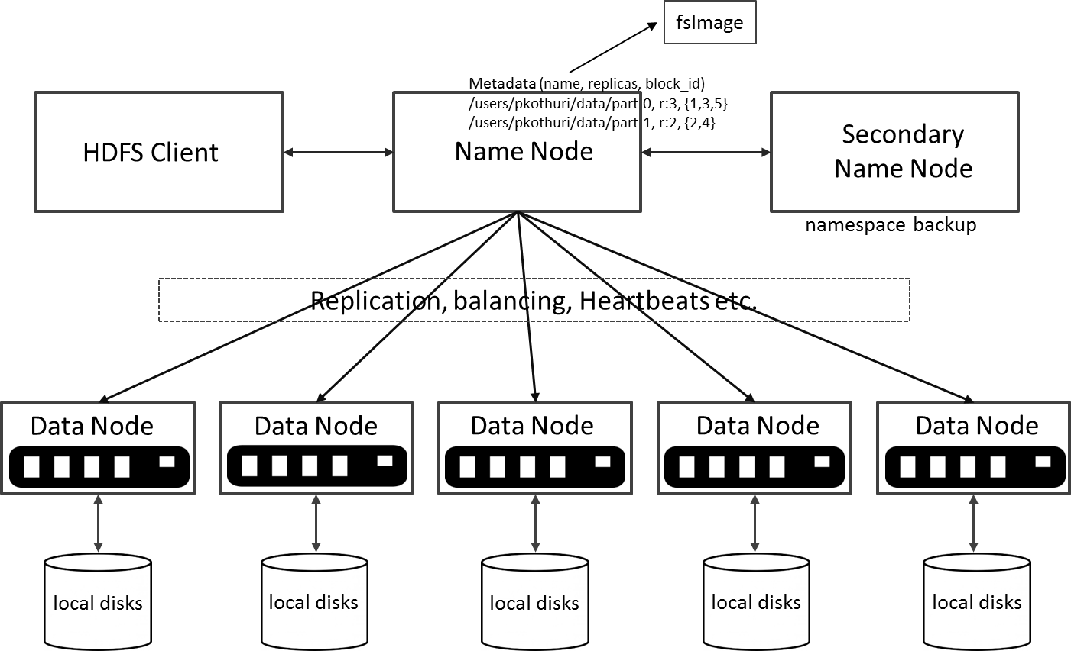
HDFS Architecture

Slide 27
DataNode
A Block Server
– Stores data in the local file system (e.g. ext3)
– Stores meta-data of a block (e.g. CRC)
– Serves data and meta-data to Clients
Block Report
– Periodically sends a report of all existing blocks to the NameNode
Facilitates Pipelining of Data
– Forwards data to other specified DataNodes

Slide 28
NameNode Metadata
Meta-data in Memory
– The entire metadata is in main memory
– No demand paging of meta-data
Types of Metadata
– List of files
– List of Blocks for each file
– List of DataNodes for each block
– File attributes, e.g creation time, replication factor
A Transaction Log
– Records file creations, file deletions. etc

Slide 29
HDFS – User Commands (dfs)
List directory contents
Display the disk space used by files
hdfs dfs –ls
hdfs dfs -ls /
hdfs dfs -ls -R /var
hdfs dfs -du /hbase/data/hbase/namespace/
hdfs dfs -du -h /hbase/data/hbase/namespace/
hdfs dfs -du -s /hbase/data/hbase/namespace/
Notes:
NameNode and DataNode each run an internal web server in order to display basic information about the current status of the cluster

Slide 30
HDFS – User Commands (dfs)
Copy data to HDFS
Copy the file back to local filesystem
hdfs dfs -mkdir tdata
hdfs dfs -ls
hdfs dfs -copyFromLocal tutorials/data/geneva.csv tdata
hdfs dfs -ls –R
cd tutorials/data/
hdfs dfs –copyToLocal tdata/geneva.csv geneva.csv.hdfs
md5sum geneva.csv geneva.csv.hdfs

Slide 31
HDFS – User Commands (acls)
List acl for a file
List the file statistics – (%r – replication factor)
Write to hdfs reading from stdin
hdfs dfs -getfacl tdata/geneva.csv
hdfs dfs -stat "%r" tdata/geneva.csv
echo "blah blah blah" | hdfs dfs -put - tdataset/tfile.txt
hdfs dfs -ls –R
hdfs dfs -cat tdataset/tfile.txt

Slide 32
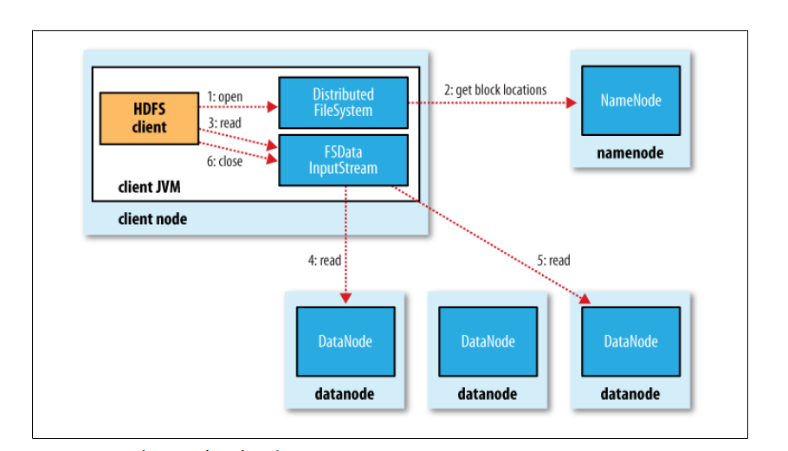
HDFS read client
Source: Hadoop: The Definitive Guide

Slide 33
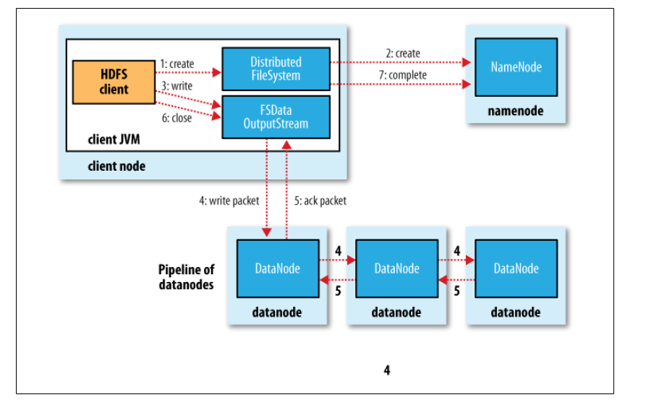
HDFS write Client
Source: Hadoop: The Definitive Guide

Slide 34
Block Placement
Current Strategy
-- One replica on local node
-- Second replica on a remote rack
-- Third replica on same remote rack
-- Additional replicas are randomly placed
Clients read from nearest replica
Would like to make this policy pluggable

Slide 35
NameNode Failure
A single point of failure
Transaction Log stored in multiple directories
– A directory on the local file system
– A directory on a remote file system (NFS/CIFS)

Slide 36
Data Pipelining
Client retrieves a list of DataNodes on which to place replicas of a block
Client writes block to the first DataNode
The first DataNode forwards the data to the next DataNode in the Pipeline
Usually, when all replicas are written, the Client moves on to write the next block in file

Slide 37
Conclusion:
We have seen:
  The structure of HDFS.
  The shell commands.
  The architecture of HDFS system.
  Internal functioning of HDFS.

Slide 38
Mapreduce internals

Slide 39
Hadoop Map Reduce
Provides:
  Automatic parallelization and Distribution
  Fault Tolerance
  Methods for interfacing with HDFS for colocation of computation and storage of output.
  Status and Monitoring tools
  API in Java
  Ability to define the mapper and reducer in many languages through Hadoop streaming.

Slide 40
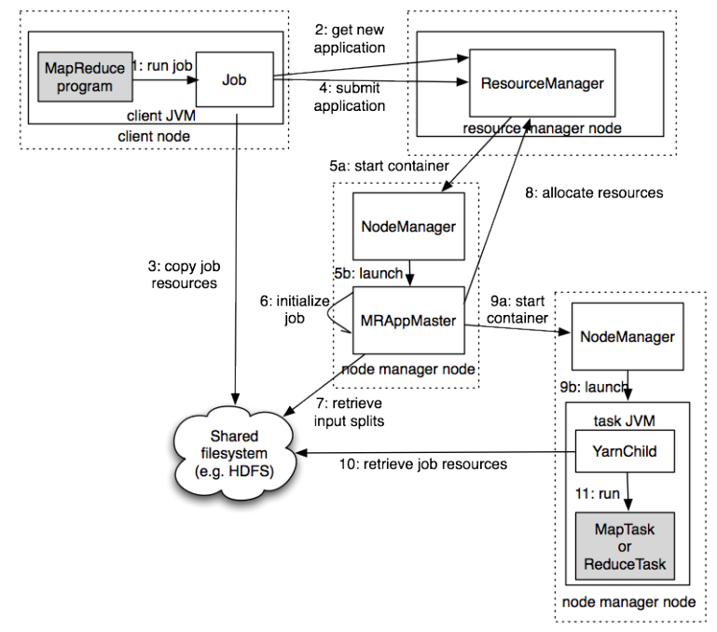
Hadoop(v2)
MR job
Source: Hadoop: The Definitive Guide

Slide 41
Wordcount program
import java.io.IOException;
import java.util.StringTokenizer;
import org.apache.hadoop.conf.Configuration;
import org.apache.hadoop.fs.Path;
import org.apache.hadoop.io.IntWritable;
import org.apache.hadoop.io.Text;
import org.apache.hadoop.mapreduce.Job;
import org.apache.hadoop.mapreduce.Mapper;
import org.apache.hadoop.mapreduce.Reducer;
import org.apache.hadoop.mapreduce.lib.input.FileInputFormat;
import org.apache.hadoop.mapreduce.lib.output.FileOutputFormat;

Slide 42
Wordcount program - Main
public class WordCount {
public static void main(String[] args) throws Exception {
Configuration conf = new Configuration();
Job job = Job.getInstance(conf, "word count");
job.setJarByClass(WordCount.class);
job.setMapperClass(TokenizerMapper.class);
job.setCombinerClass(IntSumReducer.class);
job.setReducerClass(IntSumReducer.class);
job.setOutputKeyClass(Text.class);
job.setOutputValueClass(IntWritable.class);
FileInputFormat.addInputPath(job, new Path(args[0]));
FileOutputFormat.setOutputPath(job, new Path(args[1]));
System.exit(job.waitForCompletion(true) ? 0 : 1);
} }

Slide 43
Wordcount program - Mapper
public static class TokenizerMapper extends Mapper<Object, Text, Text, IntWritable>{
private final static IntWritable one = new IntWritable(1);
private Text word = new Text();
public void map(Object key, Text value, Context context )
throws IOException, InterruptedException {
StringTokenizer itr = new StringTokenizer(value.toString());
while (itr.hasMoreTokens()) {
word.set(itr.nextToken()); context.write(word, one);
}
}
}

Slide 44
Wordcount program - Reducer
public static class IntSumReducer extends Reducer<Text,IntWritable,Text,IntWritable> {
private IntWritable result = new IntWritable();
public void reduce(Text key, Iterable<IntWritable> values, Context context )
throws IOException, InterruptedException {
int sum = 0;
for (IntWritable val : values) {
sum += val.get();
}
result.set(sum);
context.write(key, result);
}
}

Slide 45
Wordcount program - running
export JAVA_HOME=[ Java home directory ]
bin/hadoop com.sun.tools.javac.Main WordCount.java
jar cf wc.jar WordCount*.class
bin/hadoop jar wc.jar WordCount [Input path] [Output path]

Slide 46
Hadoop(v2)
MR job
Source: Hadoop: The Definitive Guide

Slide 47
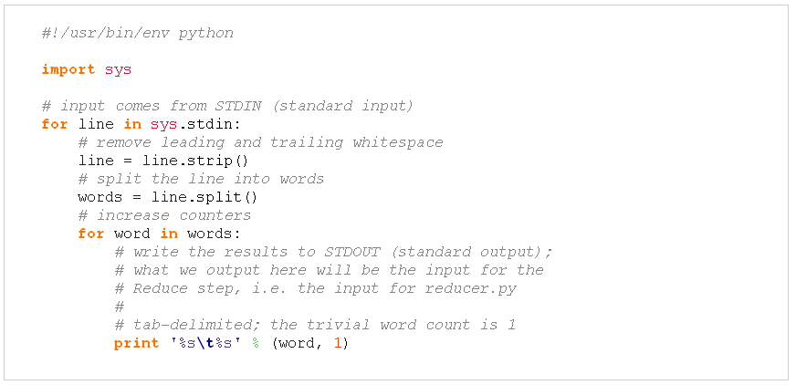
Wordcount in python
Mapper.py

Slide 48
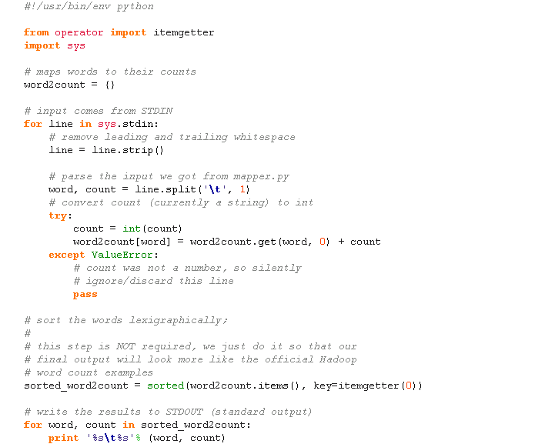
Wordcount in python
Reducer.py

Slide 49
Execution code
bin/hadoop dfs -ls
bin/hadoop dfs –copyFromLocal example example
bin/hadoop jar contrib/streaming/hadoop-0.19.2-streaming.jar -file wordcount-py.example/mapper.py -mapper wordcount-py.example/mapper.py -file wordcount-py.example/reducer.py -reducer wordcount-py.example/reducer.py -input example -output java-output
bin/hadoop dfs -cat java-output/part-00000
bin/hadoop dfs -copyToLocal java-output/part-00000 java-output-local

Slide 50
Hadoop(v2)
MR job
Source: Hadoop: The Definitive Guide

Slide 51
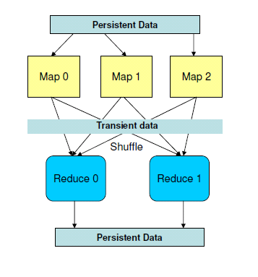
Map Reduce Data Flow

Slide 52
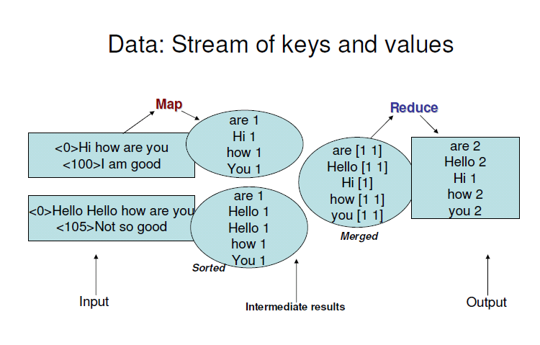

Slide 53
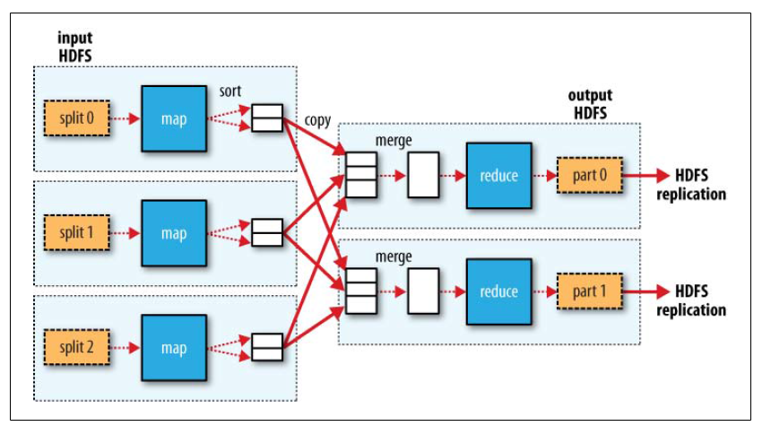
Hadoop MR Data Flow
Source: Hadoop: The Definitive Guide

Slide 54
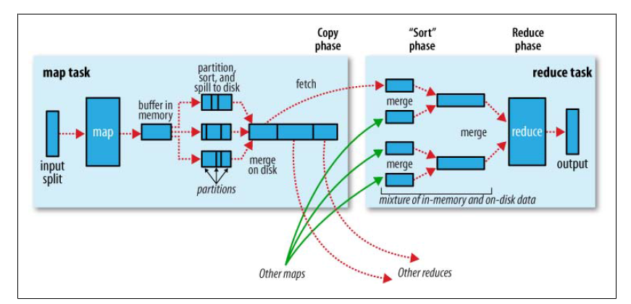
Shuffle and sort
Source: Hadoop: The Definitive Guide

Slide 55
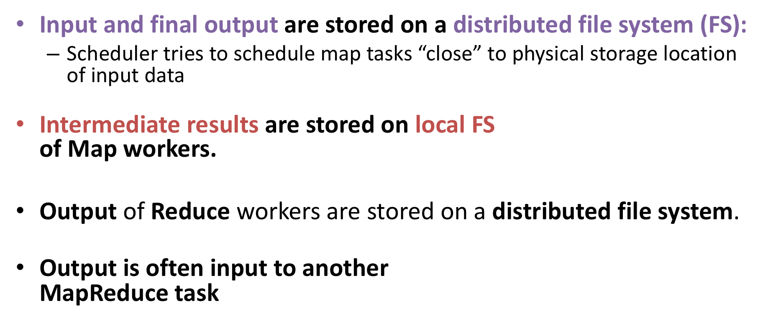
Data Flow

Slide 56
Hadoop(v2)
MR job
Source: Hadoop: The Definitive Guide

Slide 57
Fault tolerance
Comes from scalability and cost effectiveness
HDFS:
  Replication
Map Reduce
  Restarting failed tasks: map and reduce
  Writing map output to FS
  Minimizes re-computation

Slide 58
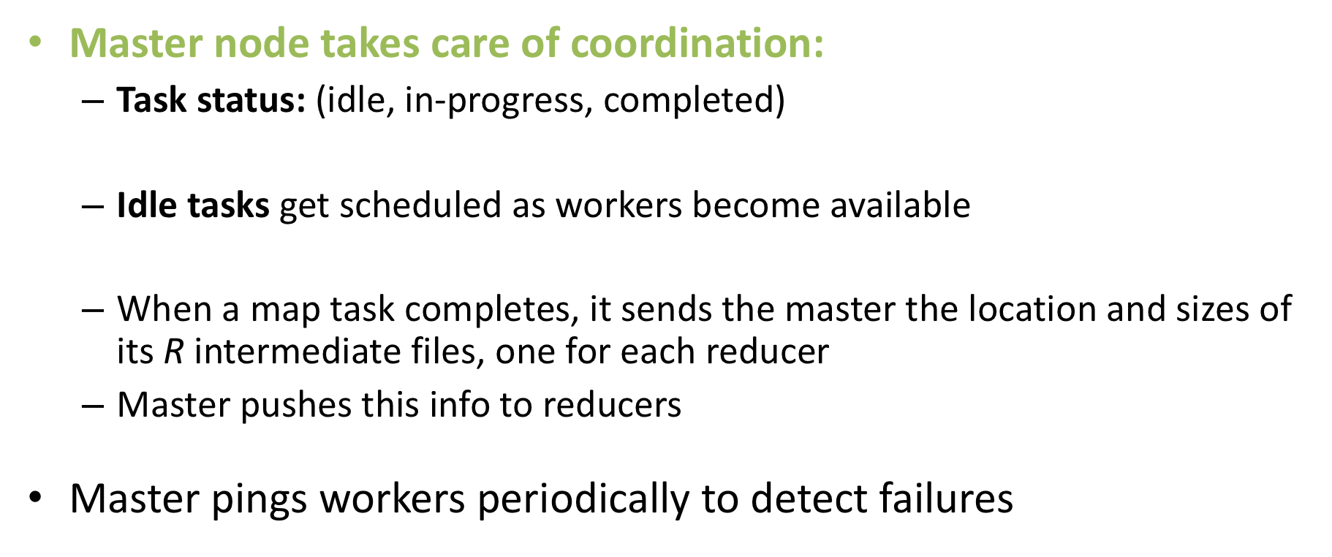
Coordination: Master

Slide 59
Failures
Task failure
  Task has failed – report error to node manager, appmaster, client.
  Task not responsive, JVM failure – Node manager restarts tasks.
Application Master failure
  Application master sends heartbeats to resource manager.
  If not received, the resource manager retrieves job history of the run tasks.
Node manager failure

Slide 60
Dealing with Failures
Map worker failure
  Map tasks completed or in-progress at
  worker are reset to idle
  Reduce workers are notified when task is rescheduled on another worker
Reduce worker failure
  Only in-progress tasks are reset to idle
  Reduce task is restarted
Master failure
  MapReduce task is aborted and client is notified

Slide 61
How many Map and Reduce jobs?
M map tasks, R reduce tasks
Rule of a thumb:
  Make M much larger than the number of nodes in the cluster
  One DFS chunk per map is common
  Improves dynamic load balancing and speeds up recovery from worker failures
Usually R is smaller than M
  Because output is spread across R files

Slide 62
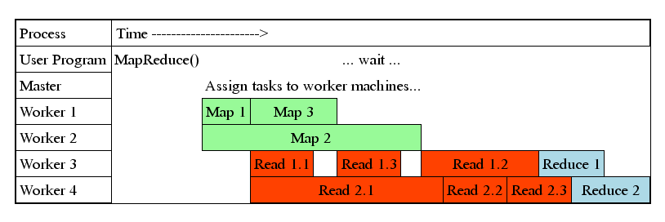
Task Granularity & Pipelining
Fine granularity tasks: map tasks >> machines
  Minimizes time for fault recovery
  Can do pipeline shuffling with map execution
  Better dynamic load balancing

Slide 63
Refinements: Backup Tasks
Problem
  Slow workers significantly lengthen the job completion time:
    Other jobs on the machine
    Bad disks
    Weird things
Solution
  Near end of phase, spawn backup copies of tasks
    Whichever one finishes first “wins”
Effect
  Dramatically shortens job completion time

Slide 64
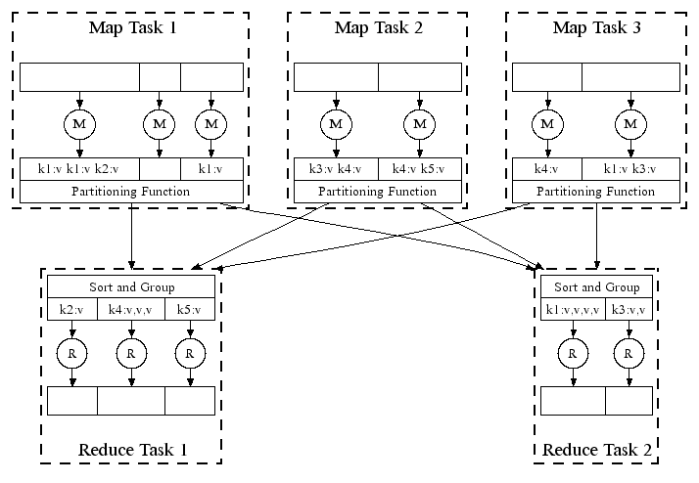
Refinement: Combiners
Often a Map task will produce many pairs of the form (k,v₁), (k,v₂), … for the same key k
  E.g., popular words in the word count example
Can save network time by
pre-aggregating values in
the mapper:
  combine(k, list(v₁)) → v₂
  Combiner is usually same
  as the reduce function
Works only if reduce
function is commutative and associative

Slide 65
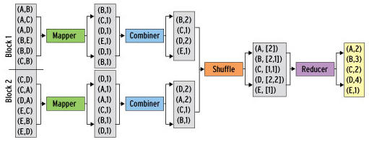
Refinement: Combiners
Back to our word counting example:
  Combiner combines the values of all keys of a single mapper (single machine):
  Much less data needs to be copied and shuffled!

Slide 66
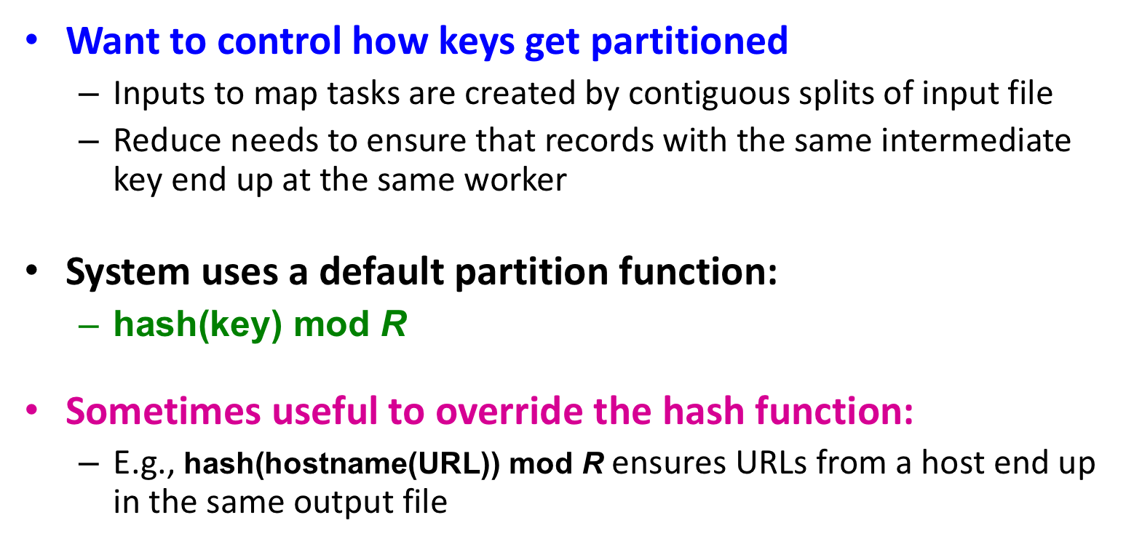
Refinement: Partition Function

Slide 67
Spark

Slide 68
Spark
Spark is an In-Memory Cluster Computing platform for Iterative and Interactive Applications.
Started in AMPLab at UC Berkeley.
Resilient Distributed Datasets.
Data and/or Computation Intensive.
Scalable – fault tolerant.
Integrated with SCALA.
Straggler handling.
Data locality.
Easy to use.

Slide 69
Map reduce data flow
Current popular programming models for clusters transform data flowing from stable storage to stable storage
E.g., MapReduce:
Map
Reduce
Input
Map
Output
Reduce
Map
Notes:
Also applies to Dryad, SQL, etc
Benefits: easy to do fault tolerance and

Slide 70
Map reduce data flow
Current popular programming models for clusters transform data flowing from stable storage to stable storage
E.g., MapReduce:
Map
Reduce
Benefits of data flow: runtime can decide where to run tasks and can automatically recover from failures
Input
Map
Output
Reduce
Map
Notes:
Also applies to Dryad, SQL, etc
Benefits: easy to do fault tolerance and

Slide 71
Motivation
Acyclic data flow is a powerful abstraction, but is not efficient for applications that repeatedly reuse a working set of data:
  Iterative algorithms (many in machine learning)
  Interactive data mining tools (R, Excel, Python)
Spark makes working sets a first-class concept to efficiently support these apps

Slide 72
Spark objective
Provide distributed memory abstractions for clusters to support apps with working sets
Retain the attractive properties of MapReduce:
  Fault tolerance (for crashes & stragglers)
  Data locality
  Scalability
Solution: augment data flow model with “resilient distributed datasets” (RDDs)
Notes:
RDDs = first-class way to manipulate and persist intermediate datasets

Slide 73
Resilient Distributed Datasets
Immutable distributed data collections inspired by Scala.
  Array, List, Map, Set, etc.
Transformations on RDDs create new RDDs.
  Map, ReducebyKey, Filter, Join, etc.
Actions on RDD return values.
  Reduce, collect, count, take, etc.
RDDs are materialized when needed – lazy execution.
RDDs are can be cached to disk – graceful degradation with memory size.
Spark framework re-computes lost splits of RDDs – fault tolerance.

Slide 74
RDDs in More Detail
An RDD is an immutable, partitioned, logical collection of records
  Need not be materialized, but rather contains information to rebuild a dataset from stable storage
Partitioning can be based on a key in each record (using hash or range partitioning)
Built using bulk transformations on other RDDs
Can be cached for future reuse

Slide 75
RDD Operations
Transformations (define a new RDD)
map filter sample union groupByKey reduceByKey join cache …
Actions (return a result to driver)
reduce collect count save lookupKey …

Slide 76
RDD Lazy execution
RDDs maintain lineage information that can be used to reconstruct lost partitions
Ex:
cachedMsgs = textFile(...).filter(_.contains(“error”))
.map(_.split(‘\t’)(2))
.cache()
HdfsRDD
path: hdfs://…
FilteredRDD
func: contains(...)
MappedRDD
func: split(…)
CachedRDD

Slide 77
Benefits of RDD Model
Consistency due to immutability
  New RDDs take input from old RDDs which cannot be changed once created.
Inexpensive fault tolerance
  Lineage rather than replicating/checkpointing data
  Only lost partitions are recomputed.
Locality-aware scheduling of tasks on partitions
Despite being restricted, model seems applicable to a broad variety of applications

Slide 78
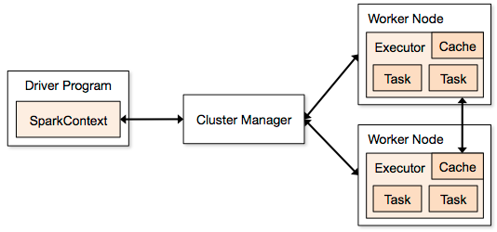
Spark cluster Architecture

Slide 79
Word Count in Spark
val lines = spark.textFile(“hdfs://...”)
val counts = lines.flatMap(_.split(“\\s”))
.reduceByKey(_ + _)
counts.save(“hdfs://...”)

Slide 80
Example: MapReduce
MapReduce data flow can be expressed using RDD transformations
res = data.flatMap(rec => myMapFunc(rec))
.groupByKey()
.map((key, vals) => myReduceFunc(key, vals))
Or with combiners:
res = data.flatMap(rec => myMapFunc(rec))
.reduceByKey(myCombiner)
.map((key, val) => myReduceFunc(key, val))

Slide 81
Spark Pi
val slices = if (args.length > 0) args(0).toInt else 2
val n = math.min(100000L * slices, Int.MaxValue).toInt // avoid overflow
val count = spark.sparkContext.parallelize(1 until n, slices).map { i =>
val x = random * 2 - 1
val y = random * 2 - 1
if (x*x + y*y <= 1) 1 else 0
}.reduce(_ + _)
println(s"Pi is roughly ${4.0 * count / (n)}")

Slide 82
Example: Logistic Regression

Slide 83
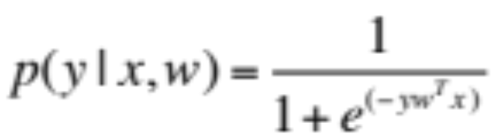
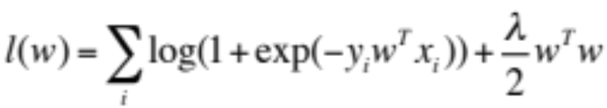
Logistic Regression
Binary Classification. y ε {+1, -1}
Probability of classes given by linear model:
Regularized ML estimate of w given dataset (x_{i}, y_{i}) is obtained by minimizing:

Slide 84
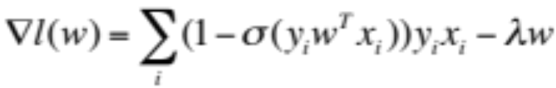
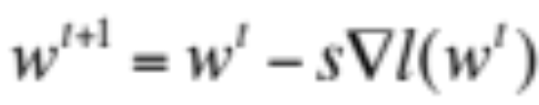
Logistic Regression
Gradient of the objective is given by:
Gradient Descent updates are:

Slide 85
Spark Implementation
val x = loadData(file) //creates RDD
var w = 0
do {
//creates RDD
val g = x.map(a => grad(w,a)).reduce(_+_)
s = linesearch(x,w,g)
w = w – s * g
}while(norm(g) > e)

Slide 86
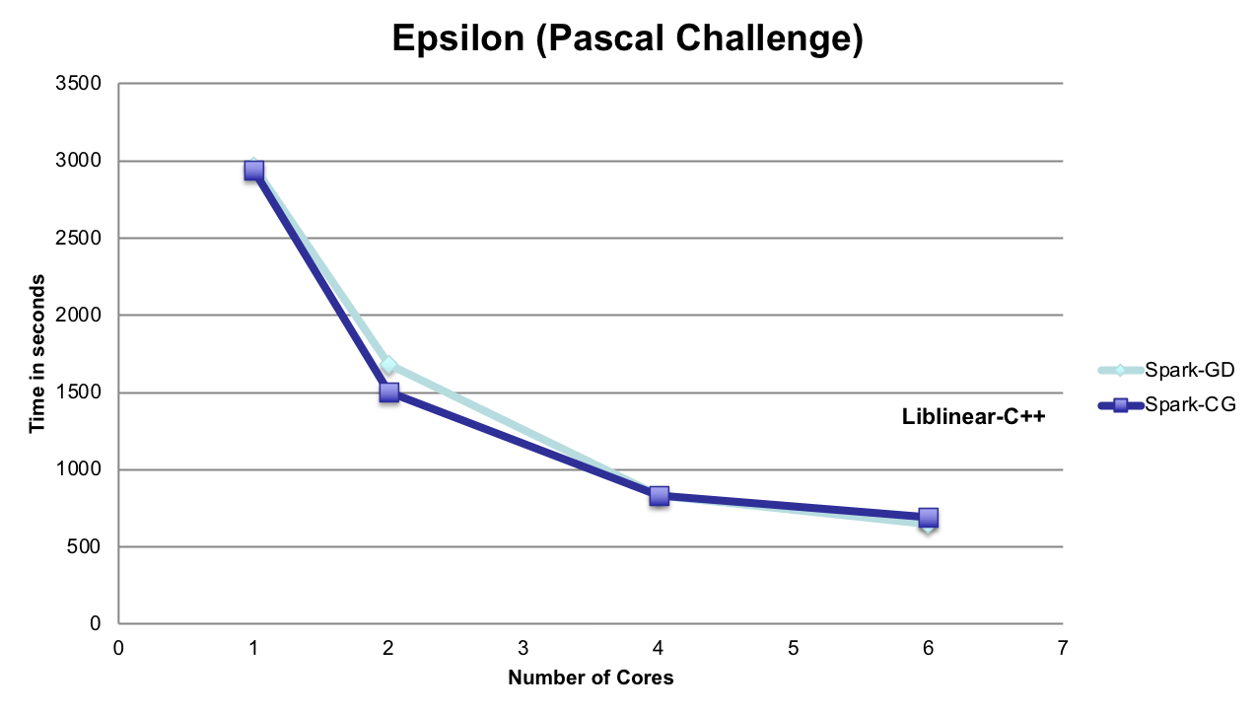
Scaleup with Cores

Slide 87
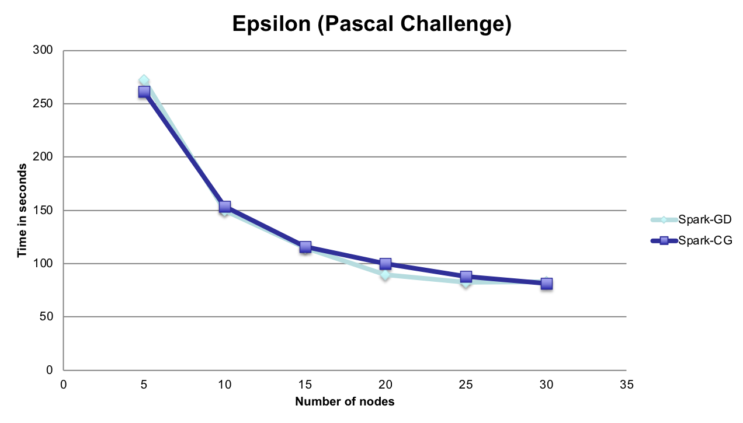
Scaleup with Nodes
996.24 s
Liblinear-C++

Slide 88
Example: Matrix Multiplication

Slide 89
Matrix Multiplication
Representation of Matrix:
  List <matrix id, Row index, Col index, Value>
  Size of matrices: First matrix (A): m*k, Second matrix (B): k*n
Scheme: For each record
  if matrix 1: emit i=1,…,n records <(row ind, i), (col ind, value)>
  Else: emit i=1,…,m records <(i , col ind), (row ind, value)>
GroupByKey: so that there are m*n groups, each with 2*k records:
  (col ind, value) for first matrix or (row ind,value) for second matrix
Foreach group and for each record (i, value):
  Find another record (j, value) such that i=j
  Multiply the corresponding values and add to sum

Slide 90
Example: PageRank

Slide 91

Basic Idea
Give pages ranks (scores) based on links to them
  Links from many pages
  ➔ high rank
  Link from a high-rank page
  ➔ high rank
Image: en.wikipedia.org/wiki/File:PageRank-hi-res-2.png

Slide 92
Algorithm
Start each page at a rank of 1
On each iteration, have page p contribute
rank_{p} / |neighbors_{p}| to its neighbors
Set each page’s rank to 0.15 + 0.85 × contribs
1.0
1.0
1.0
1.0

Slide 93
Algorithm
Start each page at a rank of 1
On each iteration, have page p contribute
rank_{p} / |neighbors_{p}| to its neighbors
Set each page’s rank to 0.15 + 0.85 × contribs
1.0
1
0.5
1
1.0
0.5
1.0
0.5
0.5
1.0

Slide 94
Algorithm
Start each page at a rank of 1
On each iteration, have page p contribute
rank_{p} / |neighbors_{p}| to its neighbors
Set each page’s rank to 0.15 + 0.85 × contribs
1.85
0.58
1.0
0.58

Slide 95
Algorithm
Start each page at a rank of 1
On each iteration, have page p contribute
rank_{p} / |neighbors_{p}| to its neighbors
Set each page’s rank to 0.15 + 0.85 × contribs
1.85
0.58
0.5
1.85
0.58
0.29
1.0
0.29
0.5
0.58

Slide 96
Algorithm
Start each page at a rank of 1
On each iteration, have page p contribute
rank_{p} / |neighbors_{p}| to its neighbors
Set each page’s rank to 0.15 + 0.85 × contribs
1.31
0.39
. . .
1.72
0.58

Slide 97
Algorithm
Start each page at a rank of 1
On each iteration, have page p contribute
rank_{p} / |neighbors_{p}| to its neighbors
Set each page’s rank to 0.15 + 0.85 × contribs
Final state:
1.44
0.46
1.37
0.73

Slide 98
Spark Implementation
val links = // RDD of (url, neighbors) pairs
var ranks = // RDD of (url, rank) pairs
for (i <- 1 to ITERATIONS) {
val contribs = links.join(ranks).flatMap {
(url, (nhb, rank)) =>
nhb.flatMap(dest => (dest, rank/nhb.size))
}
ranks = contribs.reduceByKey(_ + _)
.mapValues(0.15 + 0.85 * _)
}
ranks.saveAsTextFile(...)

Slide 99
Example: Alternating Least squares

Slide 100
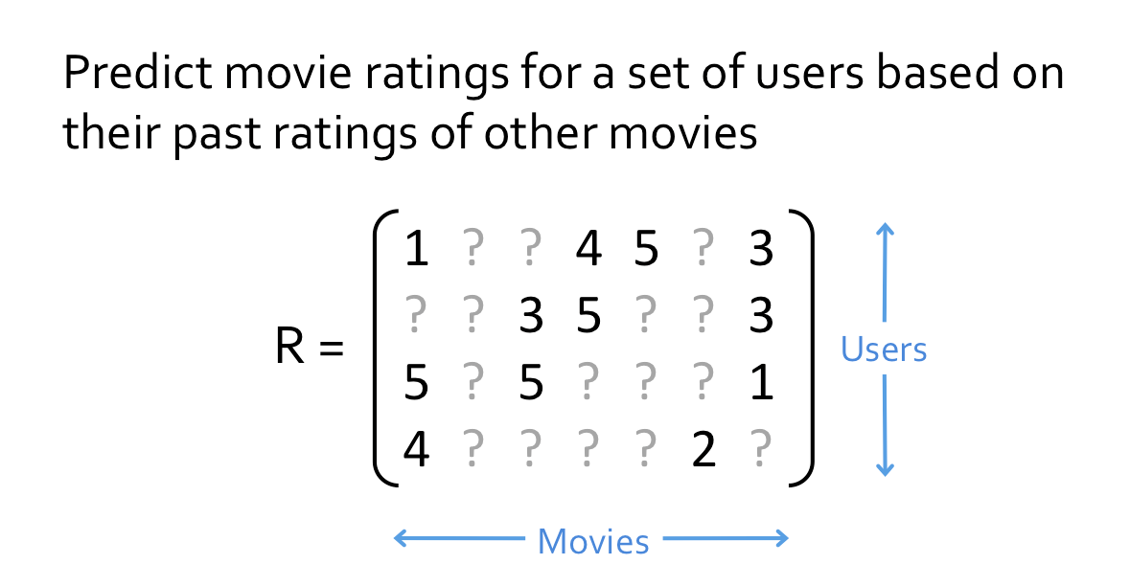
Collaborative filtering

Slide 101
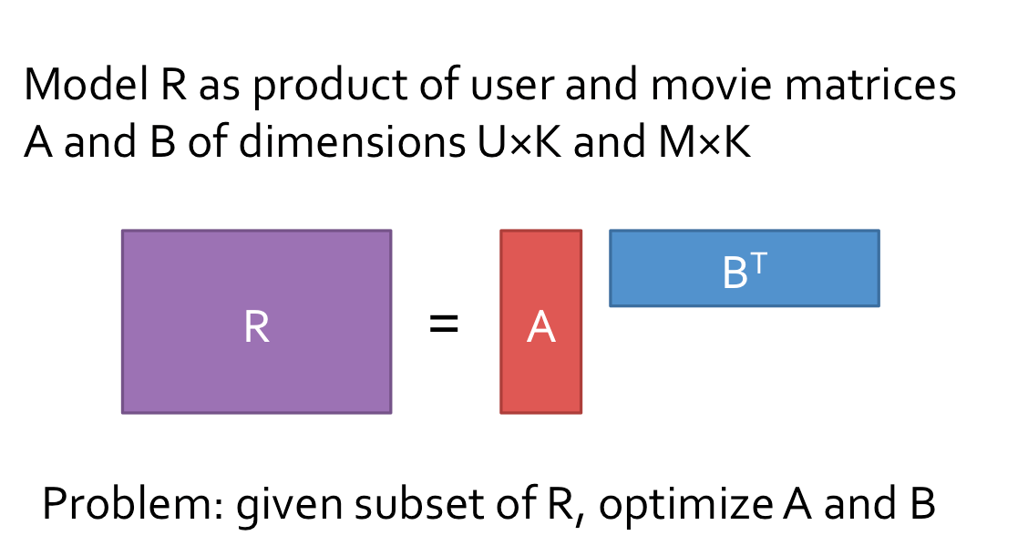
Matrix Factorization

Slide 102
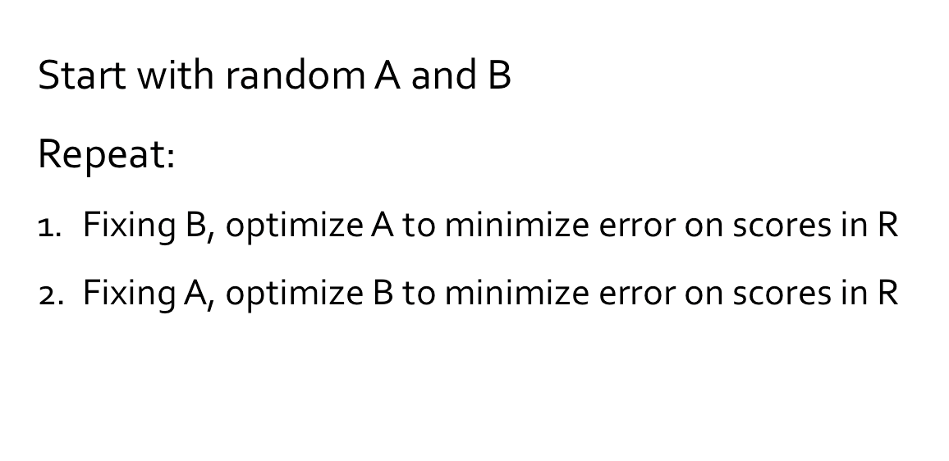
Alternating Least Squares

Slide 103
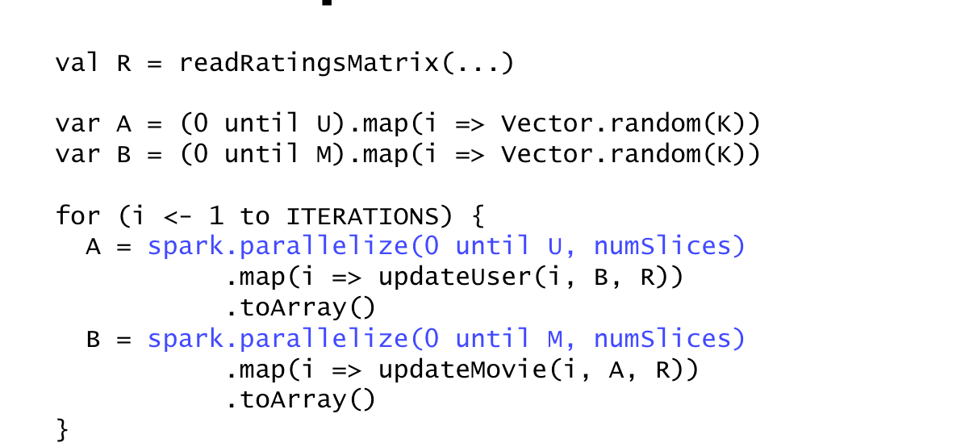
Naïve Spark ALS

Slide 104
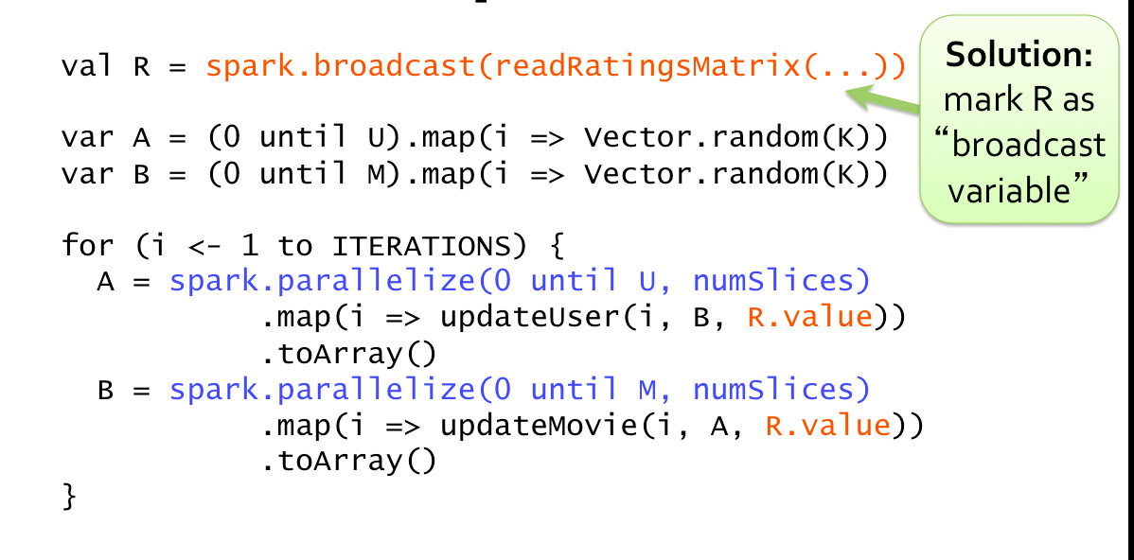
Efficient Spark ALS

Slide 105

Caching of RDDs
Load error messages from a log into memory, then interactively search for various patterns
lines = spark.textFile(“hdfs://...”)
errors = lines.filter(_.startsWith(“ERROR”))
messages = errors.map(_.split(‘\t’)(2))
cachedMsgs = messages.cache()
Base RDD
Worker
Cache 1
Transformed RDD
Driver
results
tasks
Block 1
Action
cachedMsgs.filter(_.contains(“foo”)).count
cachedMsgs.filter(_.contains(“bar”)).count
Cache 2
Worker
. . .
Cache 3
Result: full-text search of Wikipedia in <1 sec (vs 20 sec for on-disk data)
Worker
Block 2
Result: scaled to 1 TB data in 5-7 sec
(vs 170 sec for on-disk data)
Block 3
Notes:
Key idea: add “variables” to the “functions” in functional programming

Slide 106
Spark internals

Slide 107
Spark Scheduler
Input: DAGs
Creates the physical execution plan
Breaks job into stages.
Stages are DAG subgraphs with fat dependencies.
DAG Scheduler:
  Pipelines functions within a stage
  Cache-aware work reuse & locality
  Partitioning-awareto avoid shuffles
A:
B:
G:
Stage 1
groupBy
C:
D:
F:
map
E:
join
Stage 2
union
Stage 3
= cached data partition
Notes:
NOT a modified version of Hadoop

Slide 108
Physical Execution Plan
User code defines a DAG (directed acyclic graph) of RDDs
  Operations on RDDs create new RDDs that refer back to their parents, thereby creating a graph.
Actions force translation of the DAG to an execution plan
  When you call an action on an RDD, it’s parents must be computed. That job will have one or more stages, with tasks for each partition.
  Each stage will correspond to one or more RDDs in the DAG.
  A single stage can correspond to multiple RDDs due to pipelining.
Tasks are scheduled and executed on a cluster
  Stages are processed in order, with individual tasks launching to compute segments of the RDD. Once the final stage is finished in a job, the action is complete.

Slide 109
Tasks
Each task internally performs the following steps:
  Fetching its input, either from data storage (if the RDD is an input RDD), an existing RDD (if the stage is based on already cached data), or shuffle outputs.
  Performing the operation necessary to compute RDD(s) that it represents. For instance, executing filter() or map() functions on the input data, or performing grouping or reduction.
  Writing output to a shuffle, to external storage, or back to the driver (if it is the final RDD of an action such as count()).

Slide 110
Advanced examples

Slide 111
User Log Mining
Calculate the number of off-topic visits for a user.
val userData = sc.sequenceFile[UserID, UserInfo]("hdfs://...").persist()
def processNewLogs(logFileName: String) {
  val events = sc.sequenceFile[UserID, LinkInfo](logFileName)
  val joined = userData.join(events) // RDD of (UserID, (UserInfo, LinkInfo)) pairs
  val offTopicVisits = joined.filter {// Expand the tuple into its components
  case (userId, (userInfo, linkInfo)) => userInfo.topics.contains(linkInfo.topic)
  }.count()
  println("Number of visits to non-subscribed topics: " + offTopicVisits)
}

Slide 112
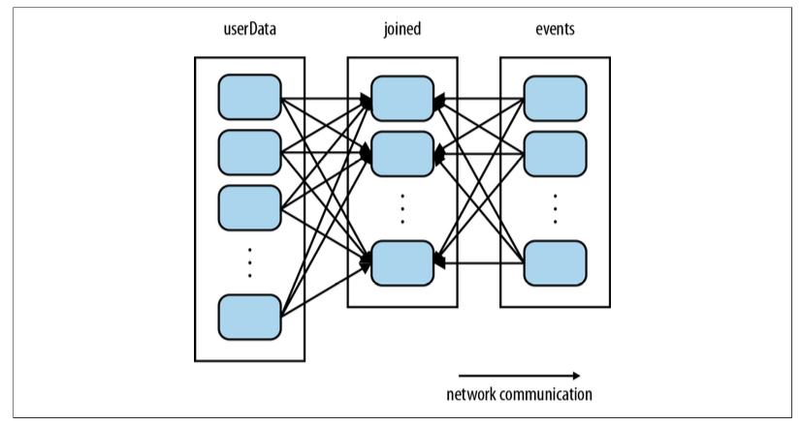
User Log Mining

Slide 113
User Log Mining
val userData = sc.sequenceFile[UserID, UserInfo]("hdfs://...")
.partitionBy(new HashPartitioner(100)) // Create 100 partitions
.persist()
def processNewLogs(logFileName: String) {
  val events = sc.sequenceFile[UserID, LinkInfo](logFileName)
  val joined = userData.join(events) // RDD of (UserID, (UserInfo, LinkInfo)) pairs
  val offTopicVisits = joined.filter {
  // Expand the tuple into its components
  (userId, (userInfo, linkInfo)) => userInfo.topics.contains(linkInfo.topic)
  }.count()
println("Number of visits to non-subscribed topics: " + offTopicVisits)
}

Slide 114
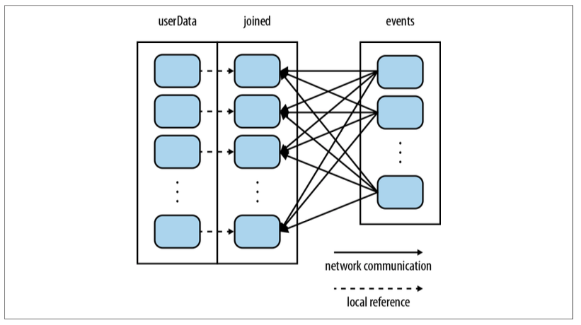
User Log Mining

Slide 115
Partitioning
RDD splits are created using a common hash function for related RDDs.
Records with same keys are mapped to same split / partition.
  Reduces network communication.
Operations benefitting from partitioning:
cogroup(), groupWith(), join(), leftOuterJoin(), rightOuter Join(), groupByKey(), reduceByKey(), combineByKey(), and lookup().
Operations affecting partitioning:
cogroup(), groupWith(), join(), leftOuterJoin(), rightOuter Join(), groupByKey(), reduceByKey(), combineByKey(), partitionBy(), sort()
mapValues() (if the parent RDD has a partitioner),
flatMapValues() (if parent has a partitioner)
filter() (if parent has a partitioner).

Slide 116
Page Rank (Revisited)
val links = sc.objectFile[(String, Seq[String])]("links") .
partitionBy(new HashPartitioner(100)).persist()
var ranks = links.mapValues(v => 1.0)
for(i<-0 until 10) {
val contributions = links.join(ranks).flatMap {
case (pageId, (nbh, rank)) => nbh.map(dest => (dest, rank / nbh.size))
}
ranks = contributions.reduceByKey((x, y) => x + y).
mapValues(v => 0.15 + 0.85*v)
}
ranks.saveAsTextFile("ranks")

Slide 117
Accumulators
val sc = new SparkContext(...) val file = sc.textFile("file.txt")
val blankLines = sc.accumulator(0)
// Create an Accumulator[Int] initialized to 0
val callSigns = file.flatMap(
line => { if (line == "") {
blankLines += 1 // Add to the accumulator
}
line.split(" ") })
callSigns.saveAsTextFile("output.txt”)
println("Blank lines: " + blankLines.value)

Slide 118
References:
Learning Spark: Lightning-Fast Big Data Analysis. Holden Karau, Andy Konwinski, Patrick Wendell, Matei Zaharia. O Reilly Press 2015.
Any book on scala and spark.
Jure Leskovec, Anand Rajaraman, Jeff Ullman. Mining of Massive Datasets. 2nd edition. - Cambridge University Press. http://www.mmds.org/
Tom White. Hadoop: The definitive Guide. Oreilly Press.

Slide 119
Thanks questions?
Email: sourangshu@cse.iitkgp.ac.in

